Slide 1
Performance analysis framework for base station placement using IEEE 802.11
Group study presentation
18.03.2020
Kirill Kukartsev
Zufar Makhmutov
Rustam Khakov

Slide 2
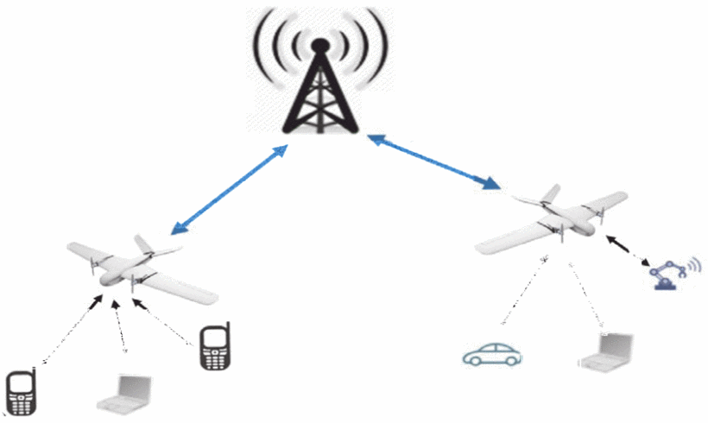
Problem Description
Mobile users’ demand increasing
Higher speed, lower latency
More data and services
Tendency to be located closely to users
2G: Macro-cells
3G - 4G: Micro-cells
5G: Pico-cells
Idea: Unmanned Aerial Vehicle with Base Stations (UAV-BS)
Problems:
How to design a placement algorithm?
How to evaluate correctness the algorithm?
How to test the algorithm in the real life?
How to coordinate the elements of mobile communication system infrastructure?
Increasing coverage and capacity
with UAV equipped with base stations, source

Slide 3
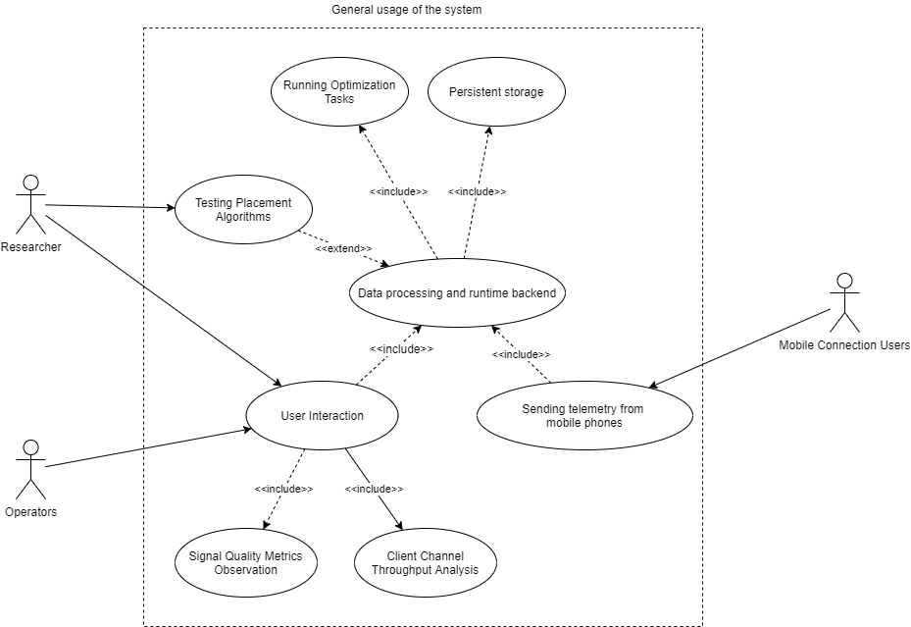
A general use-case for possible solution
A generalized use-case for a placement algorithm experimental framework

Slide 4
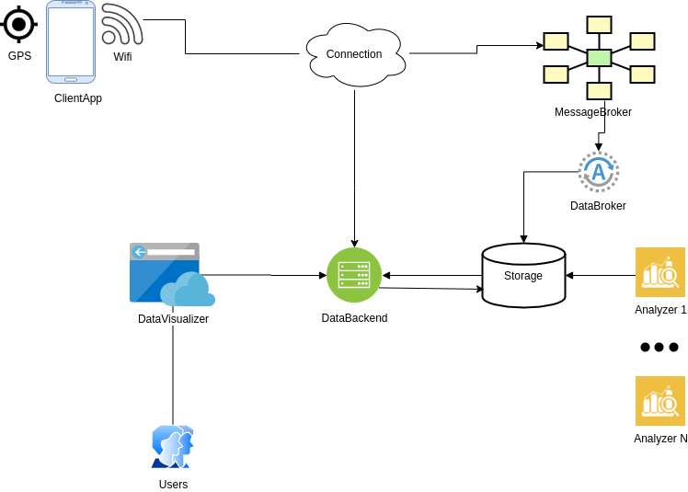
Abstract System Design
Abstract Design for component interaction for the given possible problem solution

Slide 5
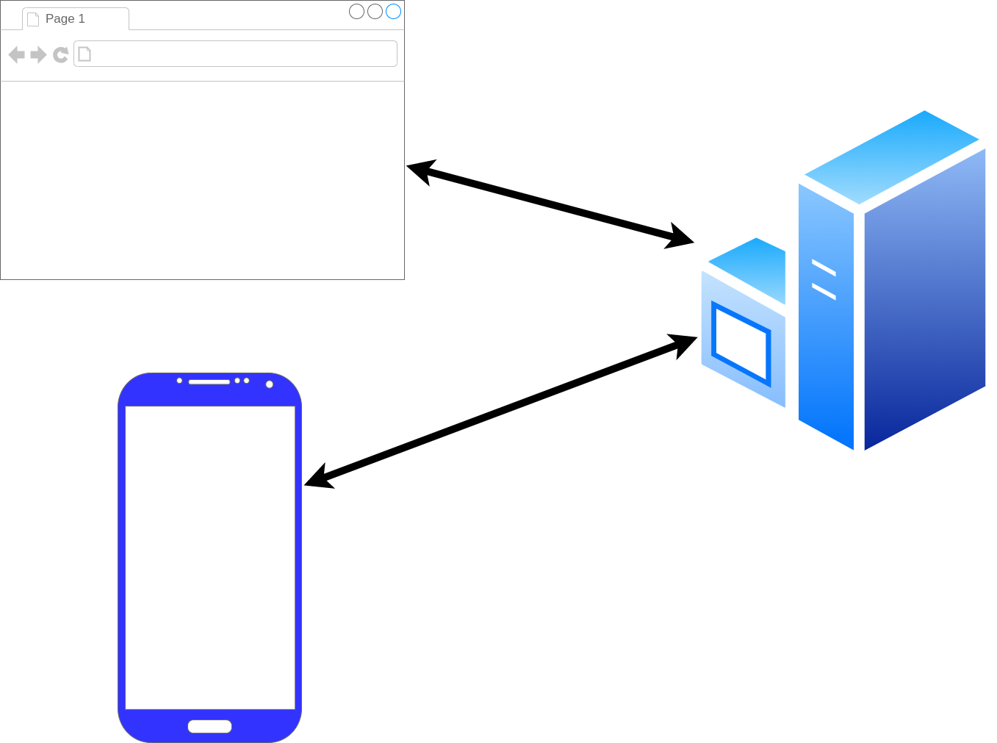
Framework Architecture Description
GPS_Frontend
GPS_Tracker
GPS_Android
Three main component of framework: a phone (GPS_Android), user interface (GPS_Frontend), data processing (GPS_Tracker)

Slide 6
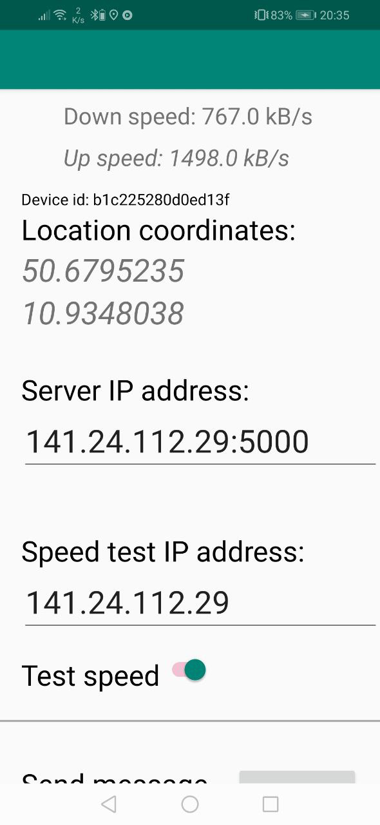
Android Component
Measure:
GPS location
Wifi connection
Connection speed using given server by MQTT or HTTP
Activities:
Send measurment result to given server
Measure data periodicaly with given timeout on background
GPS_Android installed on an Android SmartPhone

Slide 7
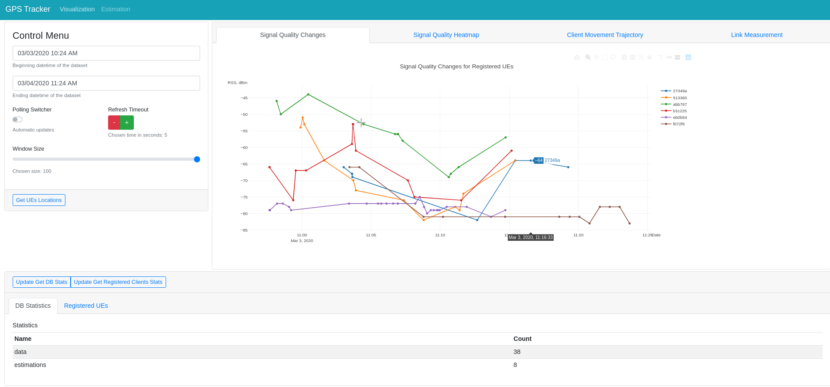
UI Component
Timeframe,
update
frequency
configuration
Location data on given
timeframe
Database
statistics
Layout of the UI implemented by GPS_Frontend. The user interact via a web-browser.

Slide 8
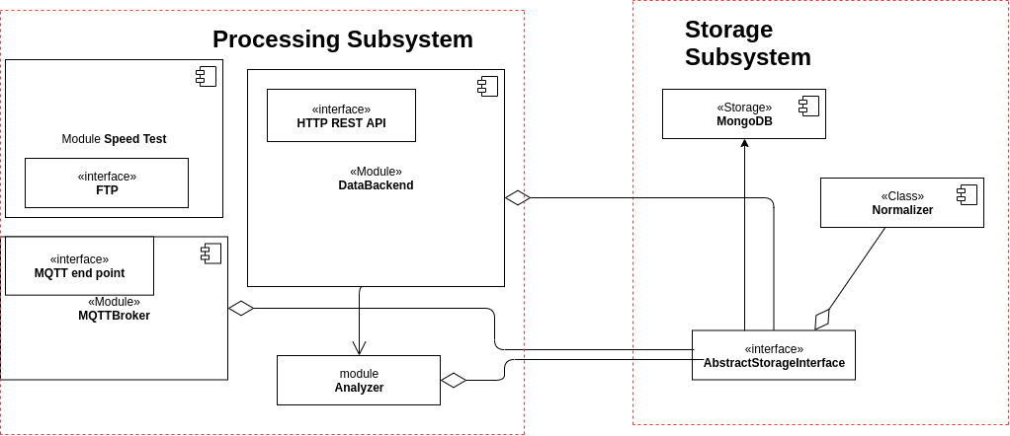
Backend Component
Component diagram for GPS_Tracker backend components.

Slide 9
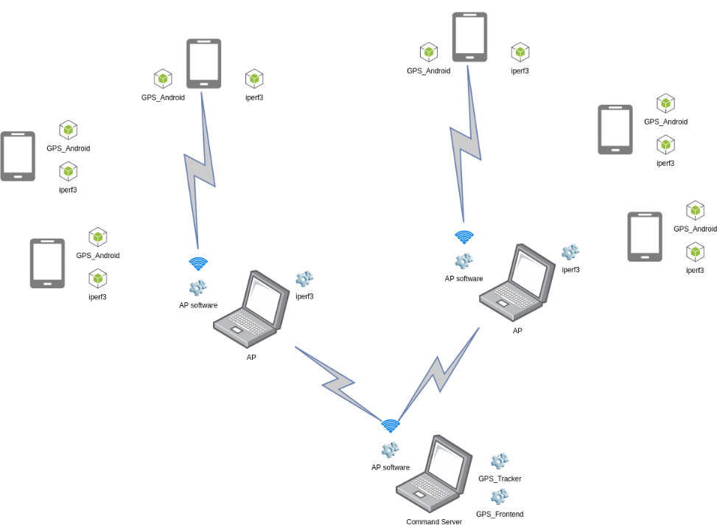
Component Layout for Experiment
Communication between components during the experiment

Slide 10
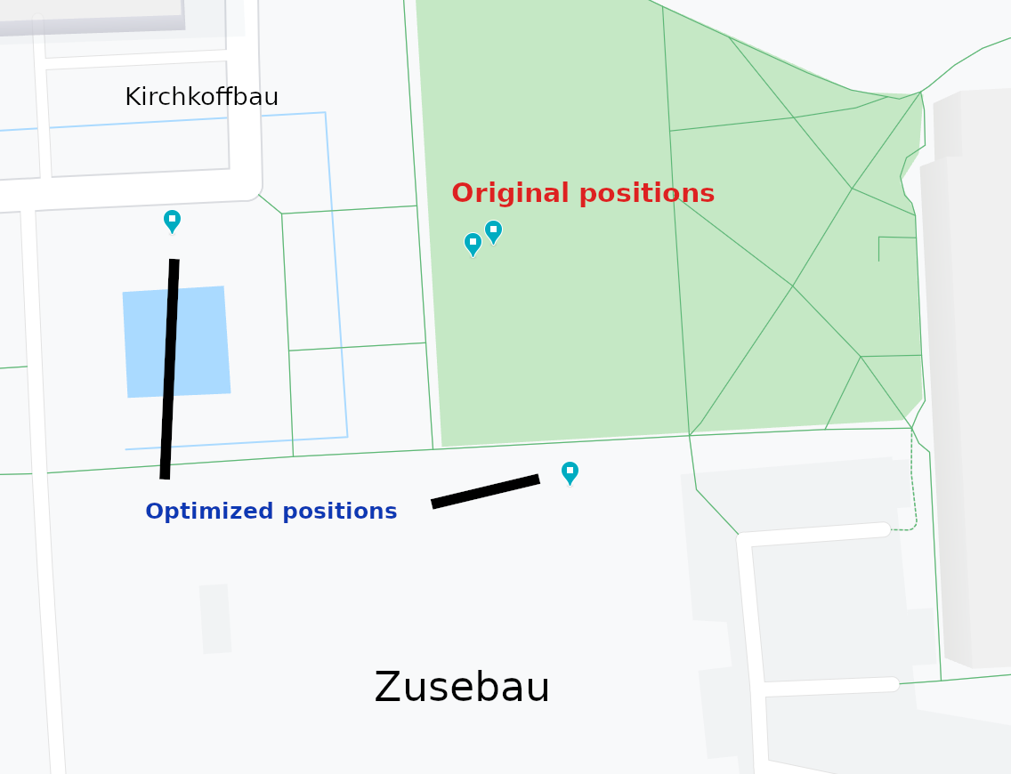
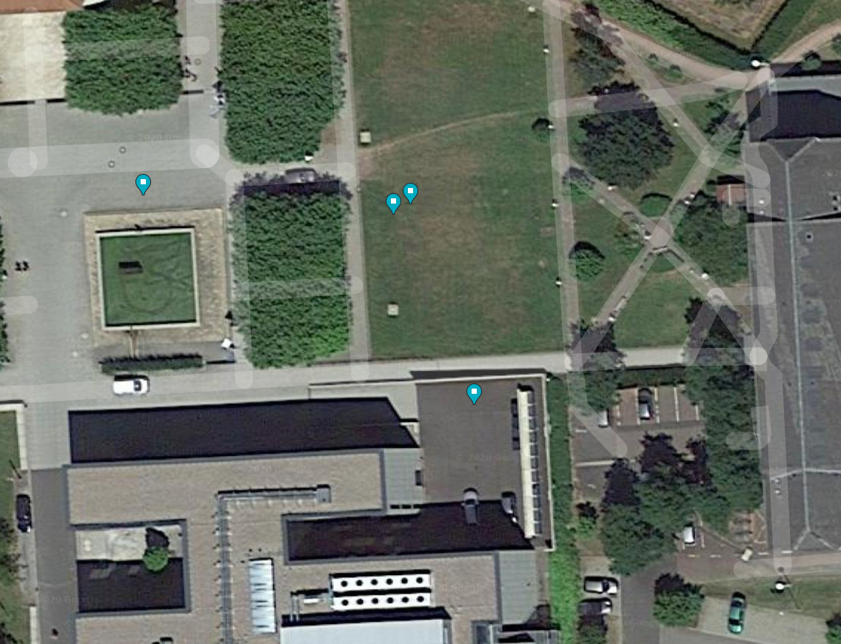
Optimized positions for UAV-BS
Logical map for the original position and suggested optimized position. Coordinates by “clustering” (K-Means) position optimization algorithms are highly biased.
Satellite map with original and suggested positions for UAV-BS layout

Slide 11
Result of experiment
Are the initial aims fulfilled?
 | Aspect | Result
Developed system | Functional properties | Works as expected, but had to alter architecture
 | Stability / Performance / Usability | Link may suffer collisions
Optimization algorithm | Provided positions | Calculated correctly
 | Stability / Performance / Usability | Extra data and/or other algo for higher accuracy
Result of 4 performed experiments

Slide 12
Conclusion
Good overall results
Applicable for UAVs layout optimization
Capability to analyze the measured data
Ability to be highly modified to obtain more reliable results.
Extensibility of the platform
But …
Framework architectural problem and nuances
Behavior of components are hard to model in the laboratory, but real experiment is exhausting.
Embedded algorithms have restrictions
The algorithms are simplified and produce biased results

Slide 13


Contact
Integrated Communication Systems Group
Ilmenau University of Technology
Univ.-Prof. Dr.-Ing. Andreas Mitschele-Thiel
fon: +49 (0)3677 69 2819
fax: +49 (0)3677 69 1226 e-mail: mitsch@tu-ilmenau.de
Visitors address:
Technische Universität Ilmenau
Gustav-Kirchhoff-Str. 1 (Informatikgebäude, Room 210) D-98693 Ilmenau
www.tu-ilmenau.de/ics

Slide 14
Appendix. Resolved problems
Table describes significant moments of workflow
Problem | Group | Resolved way
Can’t install app via apk | Android | Install using Android Studio
Data doesn’t come to CnC | Wi-Fi | Check AP
Silent crash of app | Android | Added logging to file in phone
Error related to MQTT | Software | Replace MQTT with HTTP
Hard to describe software architecture | Report | Refactor code to follow MVVM pattern

Slide 15
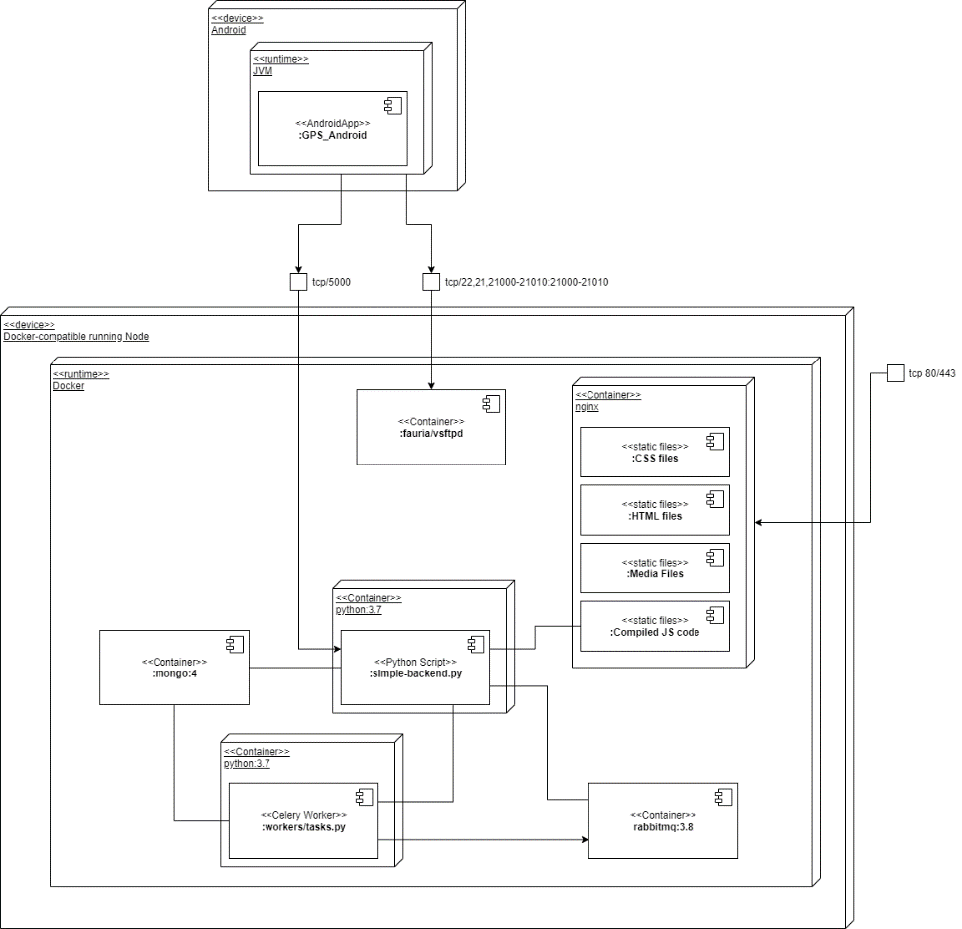
Appendix. Deployment Diagram of Framework
Dockerized infrastructure
Unified interface
Configuration in .config or OS env
A deployment case in container runtime.

Slide 16
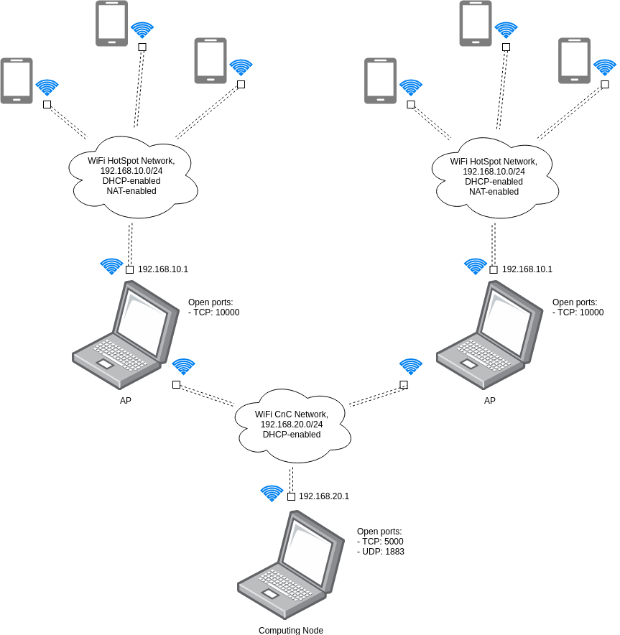
Appendix. Network Diagram of Experiment
A network scheme of experiment

Slide 17
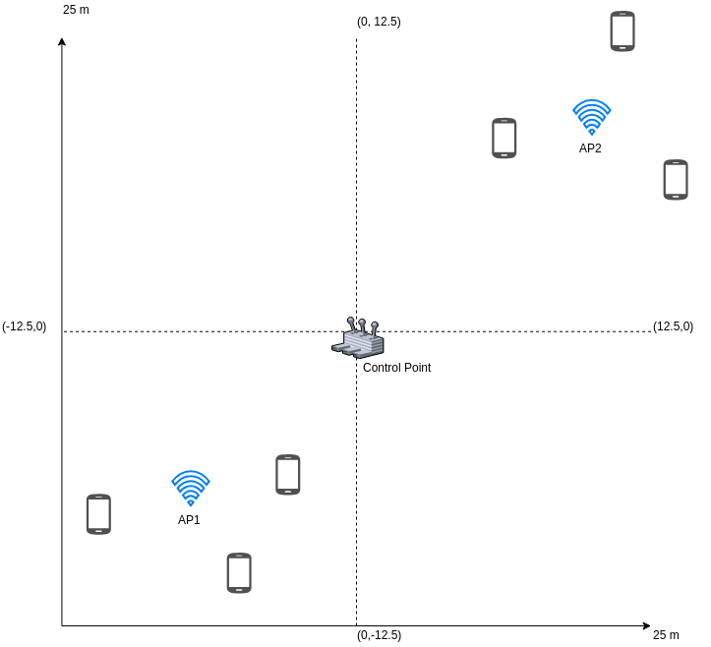
Appendix. Experiment 1/6
Experiment Case 2 – Sub-Optimal Case

Slide 18
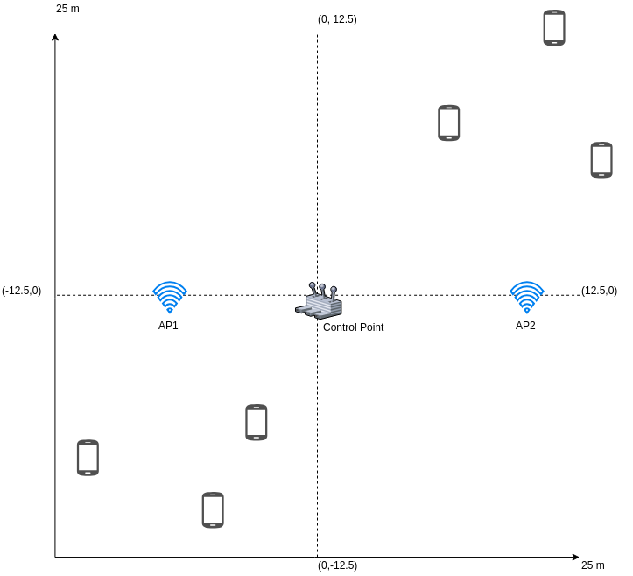
Appendix. Experiment 1/6
Experiment Case 1 – Uniform Case

Slide 19
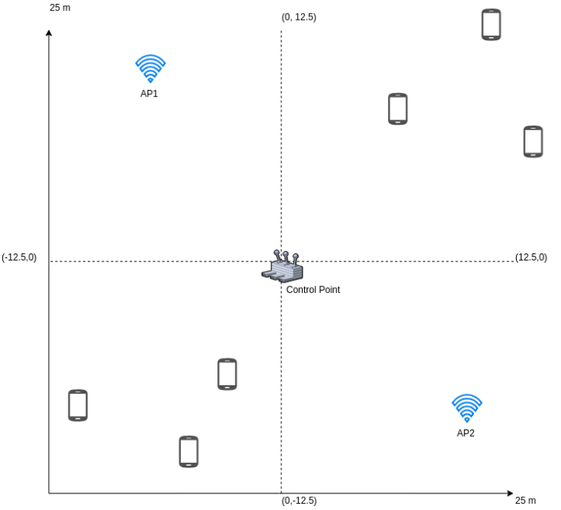
Appendix. Experiment 1/6
Experiment Case 1 – Near- Uniform Case

Slide 20
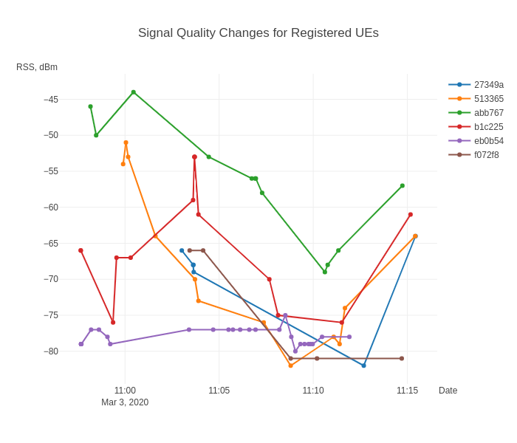
Appendix. Experiment 2/6
Overall Signal Quality (RSS) changes during the experiment.

Slide 21
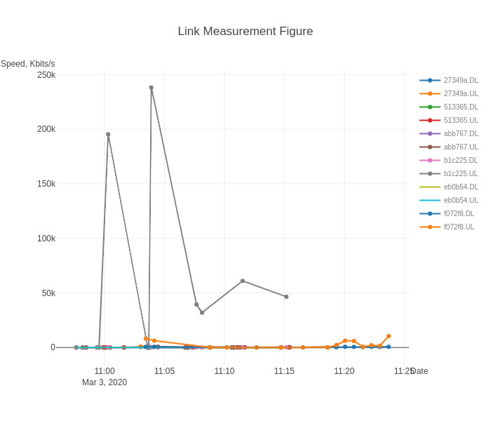
Appendix. Experiment 3/6
Measured signal link speed for uplink and downlink. Mostly metrics are degraded, cannot truly rely on them.

Slide 22
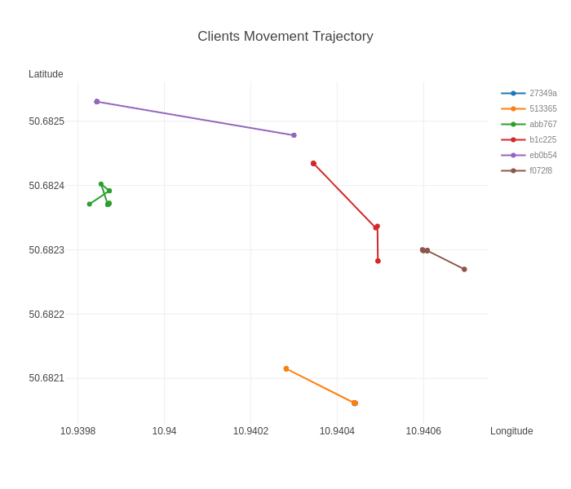
Appendix. Experiment 4/6
Overall detected coordinates changes during the experiment. Clearly shown that GPS has measurement error.

Slide 23
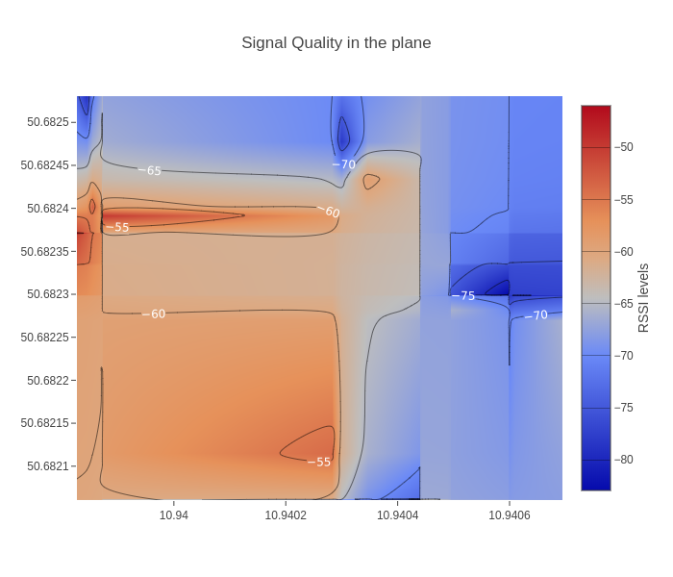
Appendix. Experiment 5/6
The heatmap of quality of WI-FI signal by GPS coordinates.

Slide 24
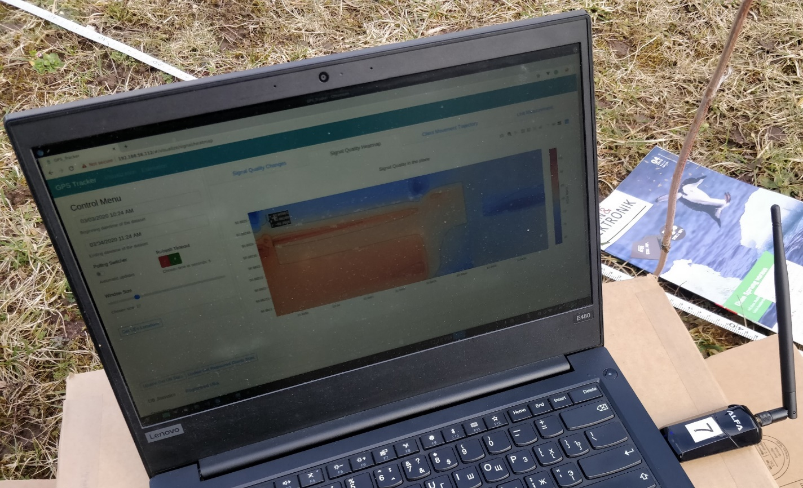
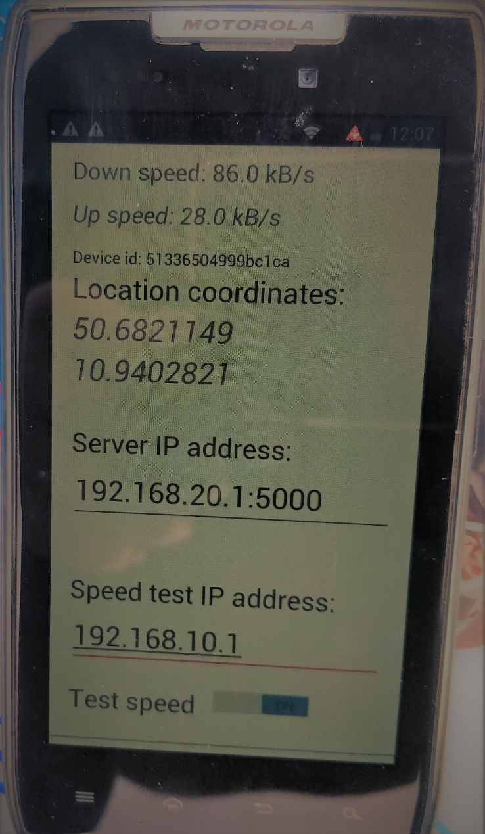
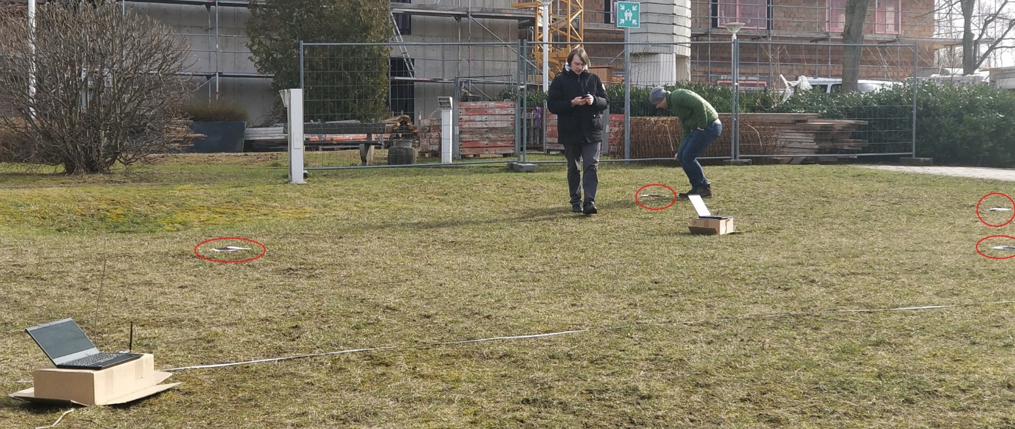
Appendix. Experiment 6/6

